Slide 1
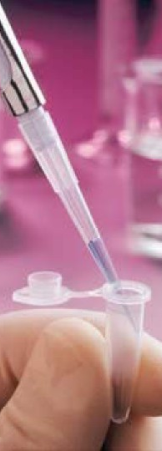
ISOENZYMES
Dr. Wasanthi Subasinghe
Department of Biochemistry & Clinical Chemistry

Slide 2
Objectives
At the end of this lecture students should be able to,
define an isoenzyme.
state how isoenzymes are formed.
list the isoenzymic forms of enzymes discussed here and their distribution
explain the diagnostic importance of the above isoenzyme.
outline laboratory methods used for the separation/identification of isoenzymes.

Slide 3
Isoenzymes/ isozymes
Physically distinct molecular forms of the same enzyme synthesized by the different tissues or found in different compartments within the cell
Catalyze the same reaction
Differ in physical, biochemical and enzymatic properties
- Km, Vmax,
- optimum pH
- Inhibitor susceptibility
- Amino acid sequence & composition
- Heat stability
- Electrophoretic mobility

Slide 4
Formation of Isoenzymes
Different genes producing isoenzymes : Malate dehydrogenase in cytosol & MC [Malate→Oxaloacetate]
Oligomeric Enzymes : En with more than one subunit. Lactate dehydrogenase, Creatinine kinase
By post translational modification: Alkaline phosphatase (Glycoprotein)

Slide 5
Identification of Isoenzymes
Can be distinguished by either physical or chemical means
Electrophoretic mobility : Agar or polyacralamide gel isoenzymes show different mobility
Heat stability
Inhibitor sensitivity
Substrate/cofactor specificity

Slide 6
Enzymes as diagnostic markers
Functional plasma enzymes: present at all times in the circulation of normal individuals and perform a physiologic function in the blood
eg: lipoprotein lipase
Nonfunctional plasma enzymes: arise from the routine normal destruction of cells, no known physiologic function in blood
Defects alters serum levels of nonfunctional plasma enzymes
Tissue damage/necrosis : ↑ plasma levels
Notes:
Decreased formation which may be due to Genetic defects, Enzyme inhibition and Lack of cofactors

Slide 7
Information from En measurements in serum
Presence of disease
Organs involved
Aetiology /nature of disease: differential diagnosis
Extent of disease-more damaged cells-more leaked enzymes in blood
Time course of disease

Slide 8
Enzymes routinely measured
NAME OF THE ENZYME | PRESENT IN | SERUM LEVELS ↑
Aspartate Amino transferase (AST) | Heart(rich) ) and Liver | Myocardial infarction, Liver disease especially with liver cell damage
Alanine Amino transferase (ALT) | Heart and Liver(rich) | Liver disease especially with liver cell damage
Alkaline Phosphatase (ALP) | Bone, intestine and other tissues | Liver disease- biliary obstruction Osteoblastic bone disease-rickets
Acid Phosphatase (ACP) | Prostate | Prostatic carcinoma

Slide 9
Enzymes routinely measured
NAME OF THE ENZYME | PRESENT IN | SERUM LEVELS ↑
γ glutamyl Transferase (γ GT) (GGT) | Liver | Liver disorder like liver cirrhosis and alcoholism
Creatine kinase (CK) | Muscle Including cardiac muscle | Myocardial infarction and skeletal muscle disease(muscular dystrophy)
Lactate Dehydrogenase (LDH) | Heart, liver, muscle, RBC | Myocardial infarction, other diseases like liver diseases, some blood diseases
α Amylase | Pancreas | Acute pancreatitis

Slide 10
Isoenzymes in diagnosis
Tissue specific : Locating the site of dammage
Isoenzyme pattern of the damaged organ/tissue reflected in serum
Lactate dehydeogenase
Creatine kinase
Alkaline phosphate
Acid phosphate
Gamma glutamyl transferase

Slide 11
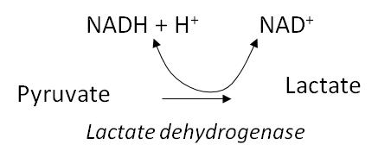
LACTATE DEHYDROGENASE (LDH)
In Anaerobic glycolysis
It is a tetramer with 4 subunits
Two types of subunits : - H = Heart
- M = skeletal muscle
H /M are products of two different genes with varying AA composition
It exists as 5 different isoenzymes with various combinations of H and M subunits

Slide 12
Isoenzyme name | Composition | Composition | Present in | Elevated in
LDH1 | ( H₄) | HHHH | Myocardium, RBC | myocardial infarction
LDH2 | (H₃M₁) | HHHM | Myocardium, RBC
LDH3 | (H₂M₂) | HHMM | Brain, Kidney
LDH4 | (H₁M₃) | HMMM | Liver, Skeletal muscle
LDH5 | (M₄) | MMMM | Skeletal muscle, Liver | Skeletal muscle and liver diseases

Slide 13
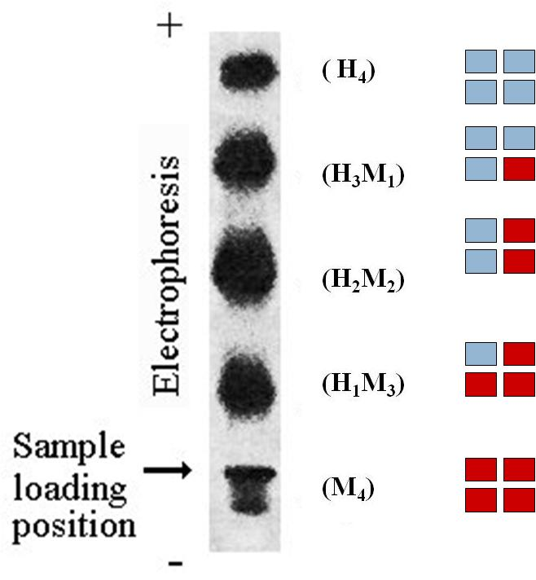
Electrophoretic mobility of LDH
The H monomer : highly (-) charged

Slide 14
Heat stability of LDH
One of the isomers may be easily heat denatured
LDH1 and LDH2 are most stable
30 min at 60 °C,
Completely denature LDH 4 & LDH 5
Partially destroy LDH3

Slide 15
Inhibitor sensitivity of LDH
In the presence of 2 mol/L urea
LDH1 is sligltly inhibited
LDH5 is completely inhibited

Slide 16
Substrate/cofactor specipicity of LDH
Lactate vs α-hydroxybutyrate
LDH1 has high affinity for α-hydroxybutyrate
Mitochondrila LDH : NAD dependant
Cytoplasmin LDH : NADP dependant

Slide 17
Creatine kinase (CK)
Creatine + ATP phosphocreatine + ADP
CK is dimer : 2 monomers M (muscle) and B (brain)
Three isoenzymes : CK1 – BB
CK2 – MB
CK3 – MM
80 % blood CK activity is due to CK3 from muscle tissue while 5% is due to CK2
 | CK1 | CK2 | CK3
Cardiac muscle |  | 20-30 % | 78-80 %
Skeletal muscle |  | 2% | 98%
Other (Brain) | predominant
Notes:
serves as energy reserve during muscle contraction

Slide 18
Alkaline phosphate (ALP)
Catalyses alkaline hydrolysis of naturally occuring and synthetic substrates
6 Isoenzymes
Alpha 1 ALP-epithelial cells of biliary canaliculi. Contribute to 10% of totla ALP activity
Alpha 2 heat labile ALP- hepatic cells (destroyed by keeping 30 min at 65˚C)
Alpha 2 heat stable ALP-Heat stable , inhibited by phenylalanine, placental, found in blood in normal pregnancy
Pre beta ALP – bone, heat labile
Gamma ALP – intestinal cells, inhibited by phenylalanine
Leukocyte ALP
Notes:
Widely distributed throughout the body

Slide 19
Acid phosphatase(ACP)
Hydrolyse phosphoric acid ester at pH 5 -6
The main source of ACP is prostate gland ; can be used as a marker for prostate diseases
Non protatic tissue (liver, spleen, RBCs & platelets)
Isozyme | Inhibitor
Tartrate labile ACP (prostatic) | tartarate ions
Non-Tartrate labile ACP (Erythrocytic) | formaldehyde

Slide 20
γ -glutamyl transferase (γ GT / GGT)
AA transport across the membranes.
Found mainly in biliary ducts of the liver, kidney and pancreas.
Enzyme activity is induced by alcohol.
γ-GT levels : liver diseases [alcohol induced liver disease, cirrhosis]

Slide 21
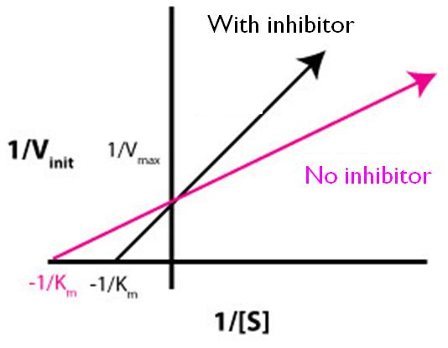
Amylase activity was measured using Iodine test in the presence and absence of Inhibitor “I” at 37 º C. Results are as follows.
State the type of Inhibition?
Sketch Line Weaver Burk plot of enzyme in the presence and absence of inhibitor
Indicate the changes in Km and V_{max} in the presence of inhibitor I

